Slide 1
Cahn-Hilliard Model with Forward Time Central Space(FTCS)
Wentao Gong

Slide 2
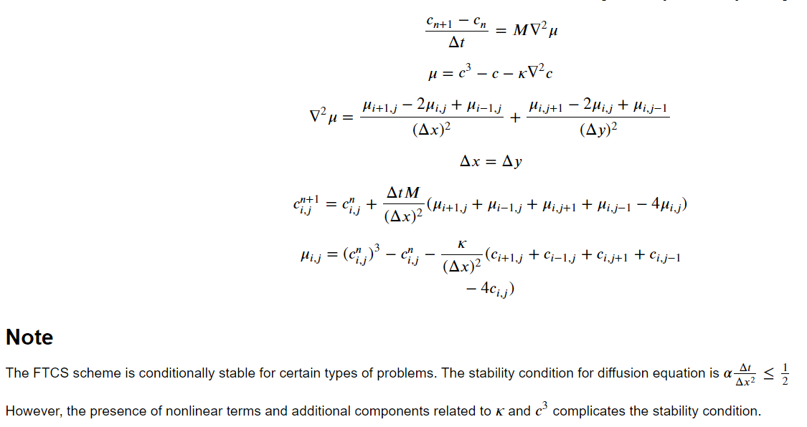
Case study 2: Finite Difference Method: Forward Time Central Space (FTCS), Explicit

Slide 3
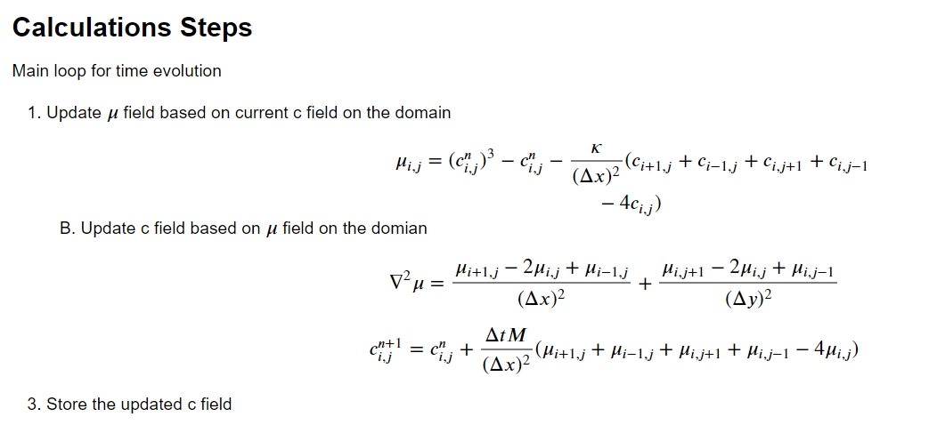

Slide 4
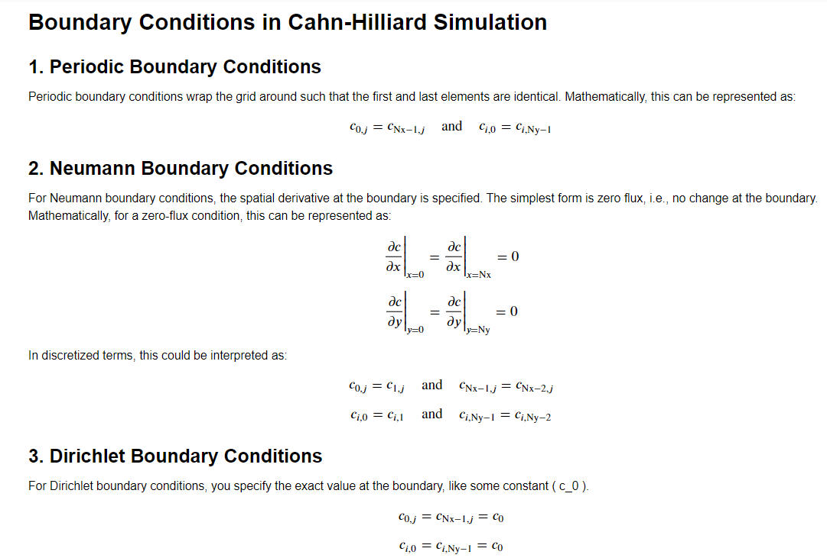

Slide 5
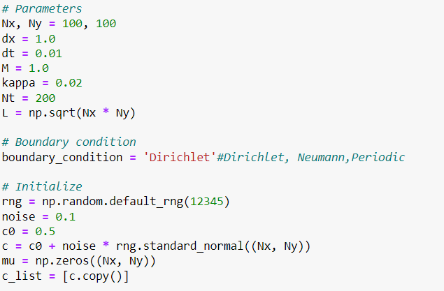

Slide 6
Case study 2: results
M=1.0, dx=1.0, dt=0.01, kappa=0.02

Slide 7
Case study 2: results
M=1.0, dx=1.0, dt=0.01, kappa=0.02

Slide 8
Future work
Modify the classical Cahn-Hilliard model by supplementing the equilibrium Ginzburg-Landau dynamics with particle-number-conserving currents
Reference: Saha, S., Agudo-Canalejo, J., & Golestanian, R. (2020). Scalar active mixtures: The nonreciprocal Cahn-Hilliard model. Physical Review X, 10(4), 041009.

